Slide 1
Sound - The Physics Perspective
CAS AICP M5 Sound
2025-10-13
Sigve Haug, PD Dr.
Data Science Lab / Mathematical Institute
University of Bern
www.dsl.unibe.ch

Slide 2

Doppler Effect in Sound
Notes:
In 2024 we may say more research specific:
“A model M is said to learn from data D with respect to the task of mapping M optimally to D, when the performance measure P improves with D."

Slide 3
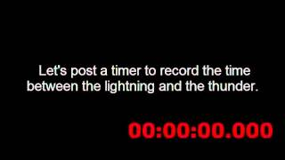
Speed of Sound
Notes:
speed of sound 343 m/s, 1235 km/h

Slide 4
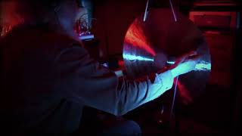
Resonance
Notes:
In 2024 we may say more research specific:
“A model M is said to learn from data D with respect to the task of mapping M optimally to D, when the performance measure P improves with D."

Slide 5
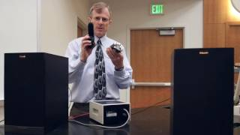
Interference
Notes:
In 2024 we may say more research specific:
“A model M is said to learn from data D with respect to the task of mapping M optimally to D, when the performance measure P improves with D."

Slide 6
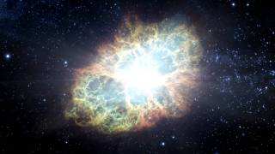
No Medium - No Sound

Slide 7

AI Generated Sound - Sportpalast
Seid ihr bereit, mit dem Führer, als Phalanx der Heimat hinter der kämpfenden Wehrmacht stehend, diesen Kampf mit wilder Entschlossenheit und unbeirrt durch alle Schicksalsfügungen fortzusetzen - bis der Sieg in unseren Händen ist?
Prompt by Göbbels, Berlin Sportpalast 1943-02-18, generation by udio.com

Slide 8
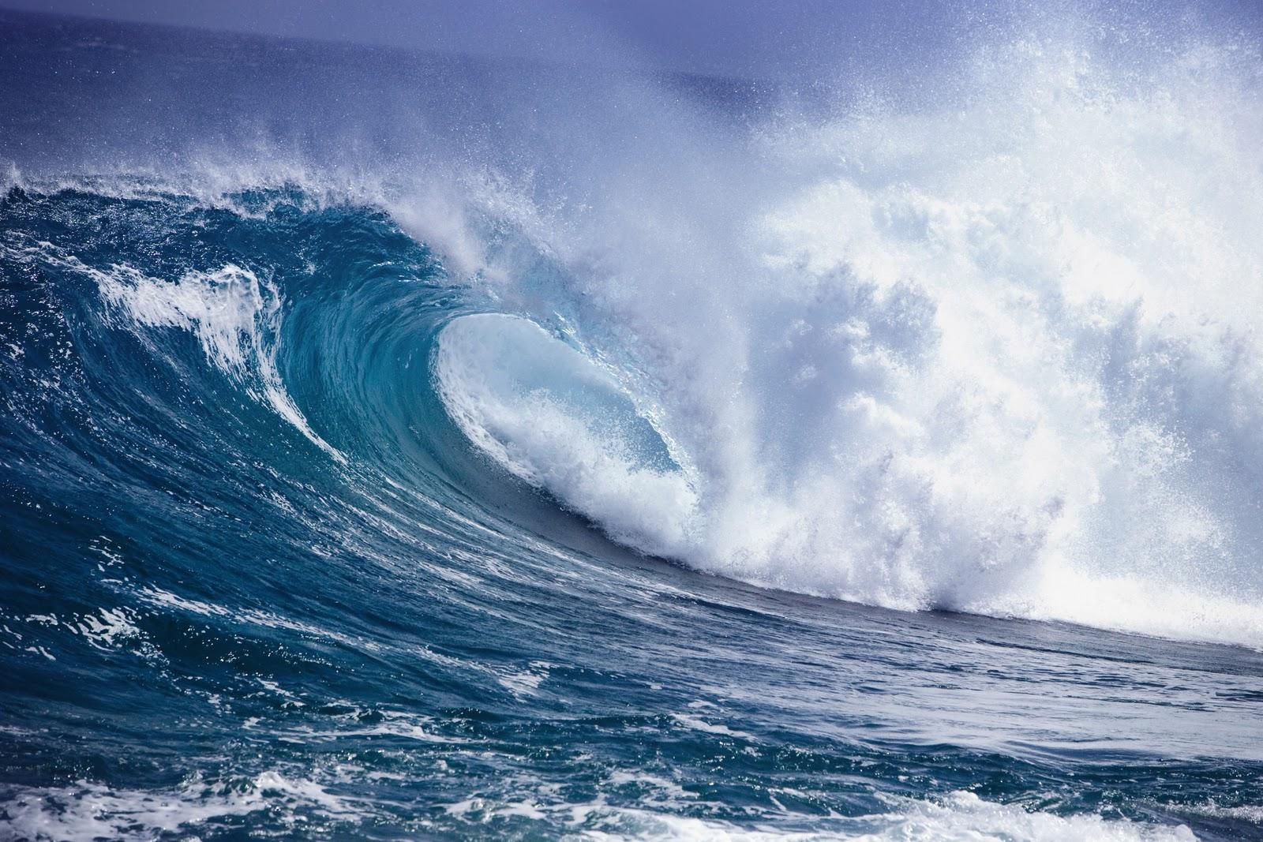
Waves in a medium (for example air)
What can account for all this ?
Doppler effect
Velocity
Resonance
Interference

Slide 9
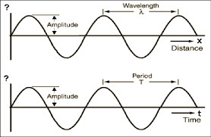
Wave (theoretical description)
v = x/t so
v = λ/T
We describe waves with amplitude, wavelength λ (distance between two peaks) and period (T) and frequency (f = 1/T)
Notes:
Peaks (crests and troughs), space and time

Slide 10
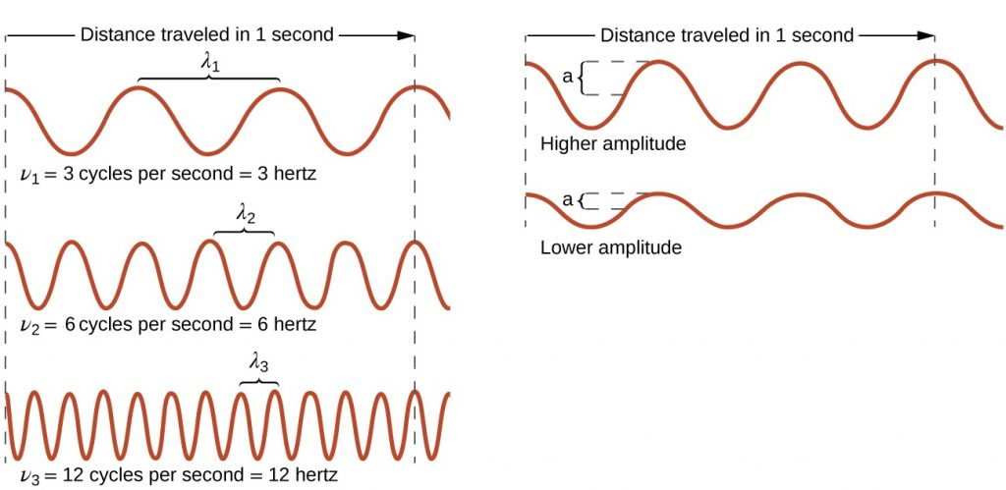
The perceived frequency is called pitch.

Slide 11
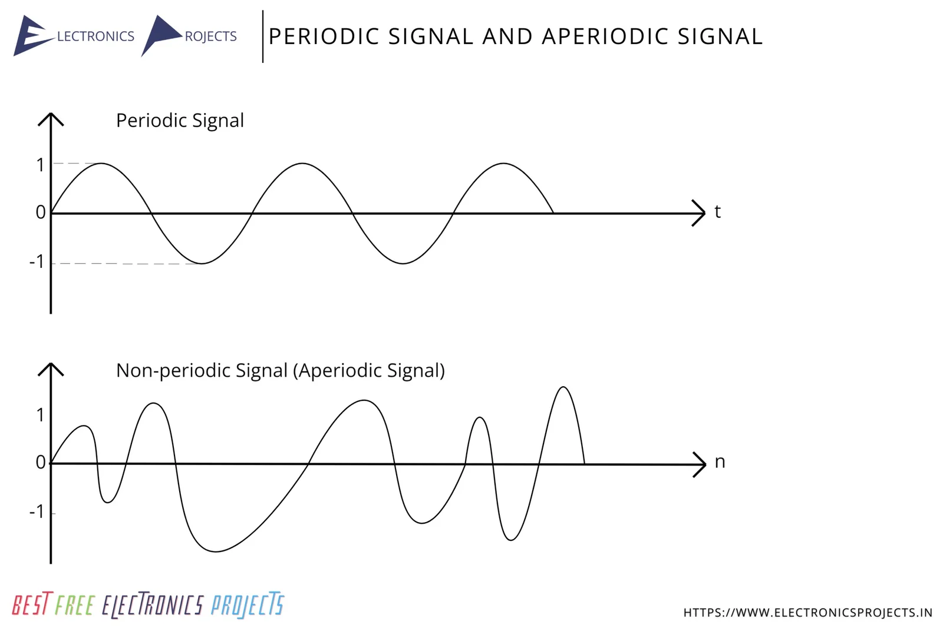
Waves can be periodic or aperiodic

Slide 12
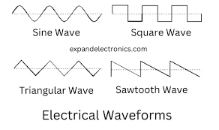
There are many different waveforms

Slide 13
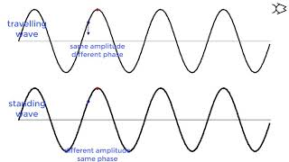
Waves can be travelling or standing (like a string on the guitar)

Slide 14
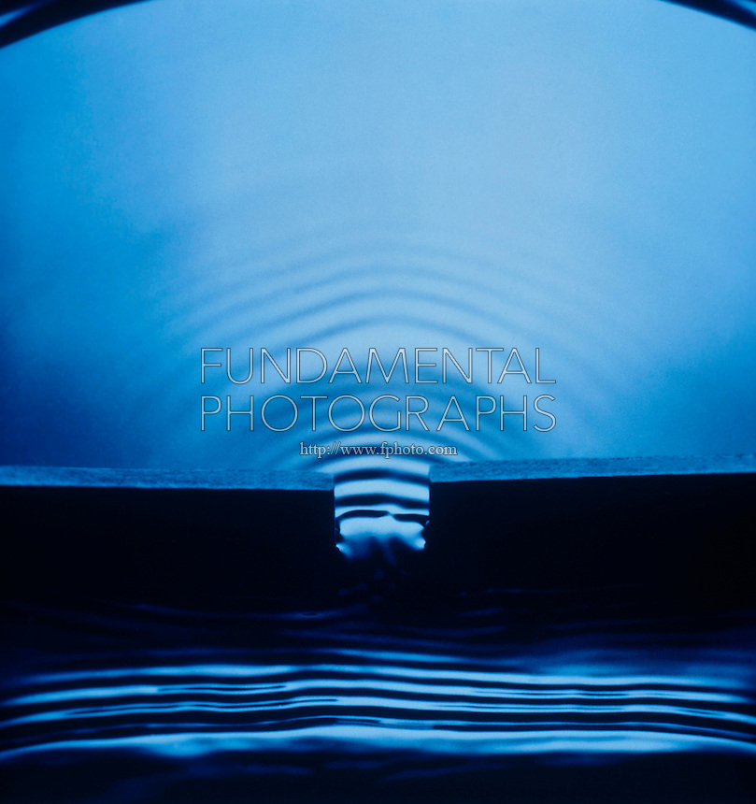
We often categorize into plane and concentric waves

Slide 15
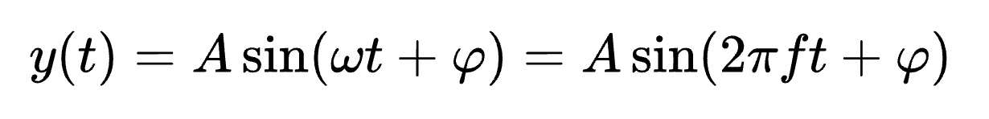
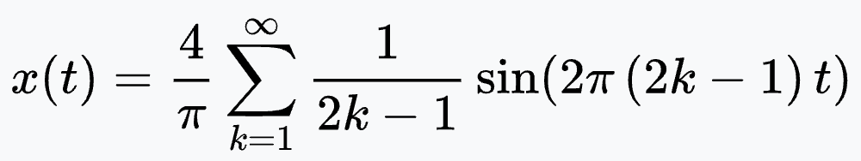
Mathematical description of (sin) waves
(...)
Any other wave can be described as a superposition (sum) of many sine waves (Fourier expansion). Example square wave:

Slide 16
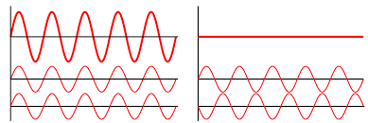
(opposed to particles, waves superimpose, i.e. they add up, both constructively and destructively)
Superposition / Interference

Slide 17
Interference
Notes:
In 2024 we may say more research specific:
“A model M is said to learn from data D with respect to the task of mapping M optimally to D, when the performance measure P improves with D."

Slide 18
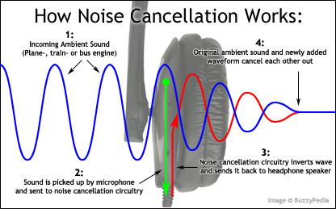
Interference

Slide 19
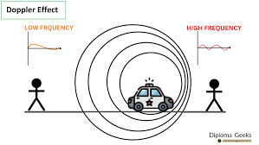

Slide 20
Doppler Effect in Sound
Notes:
In 2024 we may say more research specific:
“A model M is said to learn from data D with respect to the task of mapping M optimally to D, when the performance measure P improves with D."

Slide 21
What is sound ?
(...)
A longitudinal wave in a medium
(that can be heard)

Slide 22
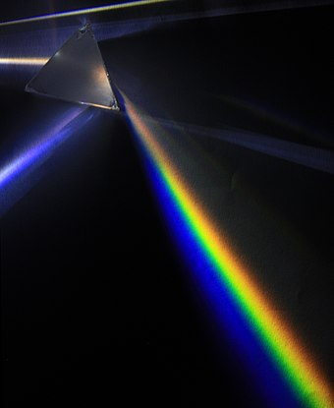
What can a sound wave do ?
Absorption
Reflection (Echo)
Refraction and Diffraction (direction change)
Transmission
Dispersion
Polarization
Interference
Doppler Effect

Slide 23
Speed of Sound
Notes:
speed of sound 343 m/s, 1235 km/h

Slide 24
Speed of sound
(...)
in air about 340 m/s
in water about 1500 m/s
in glass about 5000 m/s
in beryllium about 13000 m/s
…

Slide 25
Hearing of sound
(...)
Humans can hear from 20 to 20’000 Hz
Frequencies below 20 we call infrasound
Frequencies above 20’0000 we call ultrasound
Dogs can hear up to 30’000
Dolphins and bats up to 100’000
Perception range degrades with age, mostly in the high frequency domain
…

Slide 26
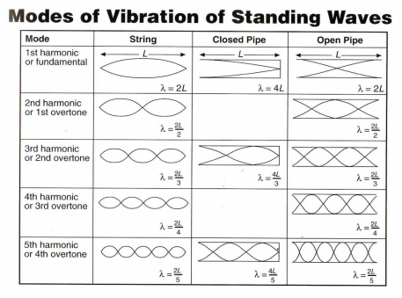

Slide 27

Let’s play !
(...)
Go to this page with your phone and try out
Different pitches
What are the smallest and biggest frequencies you can hear?
Different waveforms
Or go to the link with your laptop
https://onlinetonegenerator.com/

Slide 28
Digitizing Sound
(...)
Longitudinal mechanical waves are analog
When we record sound, with a microphone, it creates an electrical current that is digitized into a on-off signal (squared waveform)
Τhe on-off (1 or 0) signal can be manipulated by a computer, for example used to train an AI model that can generate a song
The output on-off signal is then made analog to steer the vibrations of a loudspeaker
…

Slide 29
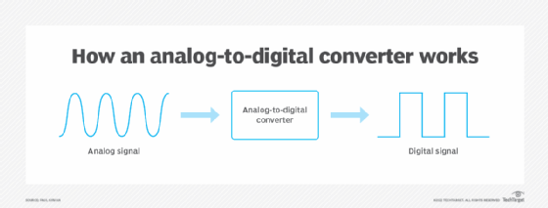
Digitizing
(...)

Slide 30
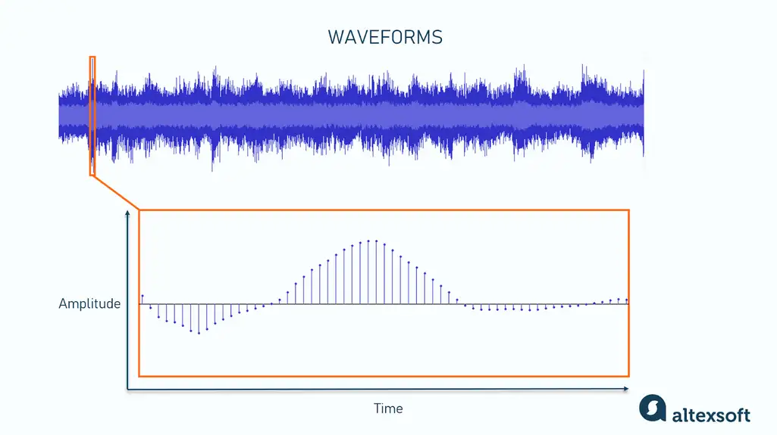
Representation of sound - waveforms
(...)
Data heavy - CD typically has 44’000 samples per second

Slide 31
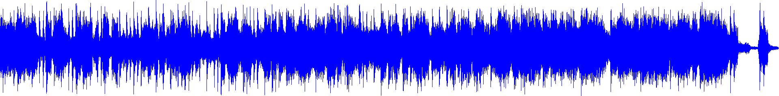
Waveform of Sportpalast
(...)
Done with https://audioalter.com/waveform

Slide 32
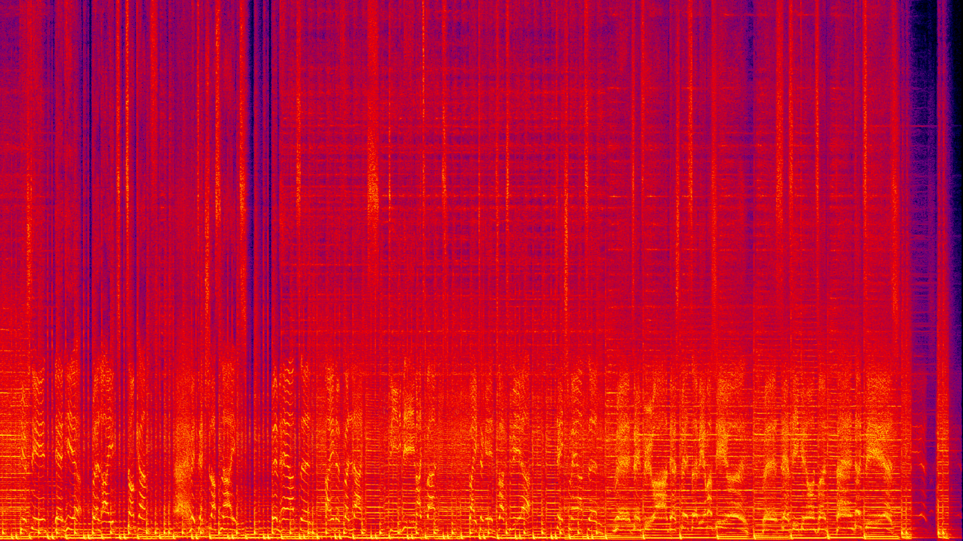
Spectrogram of Sportpalast
(...)
Sound can be represented as pictures and then processed with image techniques
Done with https://audioalter.com/spectrogram

Slide 33
Tool | Best For | Open Source | Architecture | Key Features | Pricing
Suno | Complete songs with vocals | No (Proprietary) | Transformer-based | Text-to-song, v4.5 model, stem separation, multi-language vocals, mobile app | Free plan; paid tiers for commercial use
Stable Audio | Long-form music generation | Yes (Open) | Diffusion Transformer (DiT) on latent representation | Up to 4m 45s generations, 21.5 Hz latent rate, text conditioning | Open model available; commercial license for business use
MusicGen | Customizable music from text | Yes (Open) | Transformer-based autoregressive decoder with EnCodec | Text/melody conditioning, multiple styles, local operation capability | Free and open source (Meta/Facebook Research)
Udio | Professional-quality compositions | No (Propetary) | Likely diffusion-based (not disclosed) | Advanced editing (extending/inpainting/remixing), community sharing, professional output | Free plan; paid subscriptions for downloads
AIVA | Orchestral & cinematic music | No (Proprietary) | Deep learning + reinforcement learning | 250+ styles, MIDI editor, trained on classical composers, SACEM recognition | Free (with attribution); Standard & Pro for full rights
I'll search for more technical details about these tools' architectures and open-source status.Based on my research, here's a refined table with the top 5 music generation tools, including their open-source status and architecture:
Key Technical Notes:
Suno's Bark model is transformer-based for text-to-audio generation, though their main music platform architecture isn't fully disclosed
Stable Audio Open 1.0 is a latent diffusion model based on transformer architecture, making it one of the few fully open-source options
MusicGen uses a transformer-based autoregressive decoding model with EnCodec for audio tokenization
AIVA is based on deep learning and nforcement learning architectures, trained on classical music
Most proprietary tools (Suno, Udio) don't fully disclose their exact architectures for competitive reasons

Slide 34
Ethical Concerns regarding AI4Sound ?
Is there a copyright on the generated sound?
Was sound for the training with copyright?
Is it a problem that you cannot distinguish your mother’s voice from an AI trained voice (fakes)?
Will human sound artists and makers lose their jobs?
Sustainability
Health
Training bias (low intellectual qualtiy)
Is This What We Want ?
Notes:
Voice cloning, copyright, what is original, what is fake, bias in training data

Slide 35
Summary
Sound is a (hearable) longitudinal mechanical wave
Apart from polarization it thus has the typical wave features (in particular superposition / interference)
Digitized sound can be used to train machine learning models that can then generate new sound like speech and music

Slide 36
Check your learning outcomes
link to google form : https://forms.gle/XVp5qnexiDCwSjHq7

Slide 37
Exercises
Create yourself a GitHub repository for your CAS
Play with acoustics using this jupyter notebook
https://colab.research.google.com/drive/10-IqNtkEqXM8t1Ts4p34RXH-FBCCne7m?usp=sharing

